Slide 1
Cardiovascular Disease Indicators

Slide 2
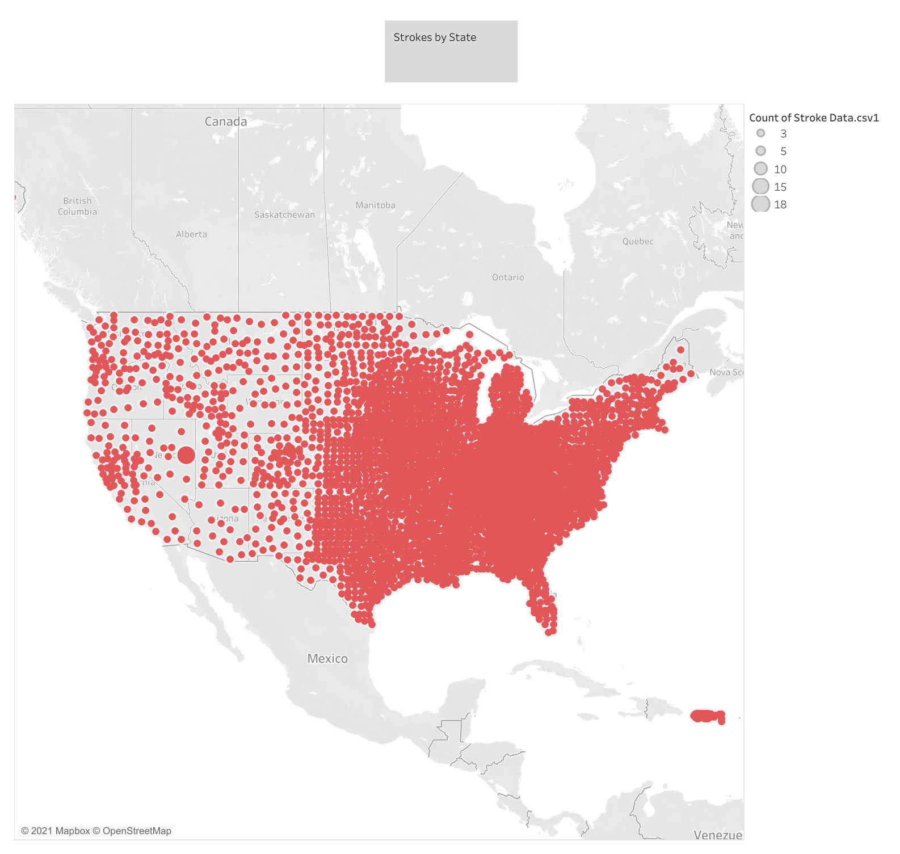

Slide 3
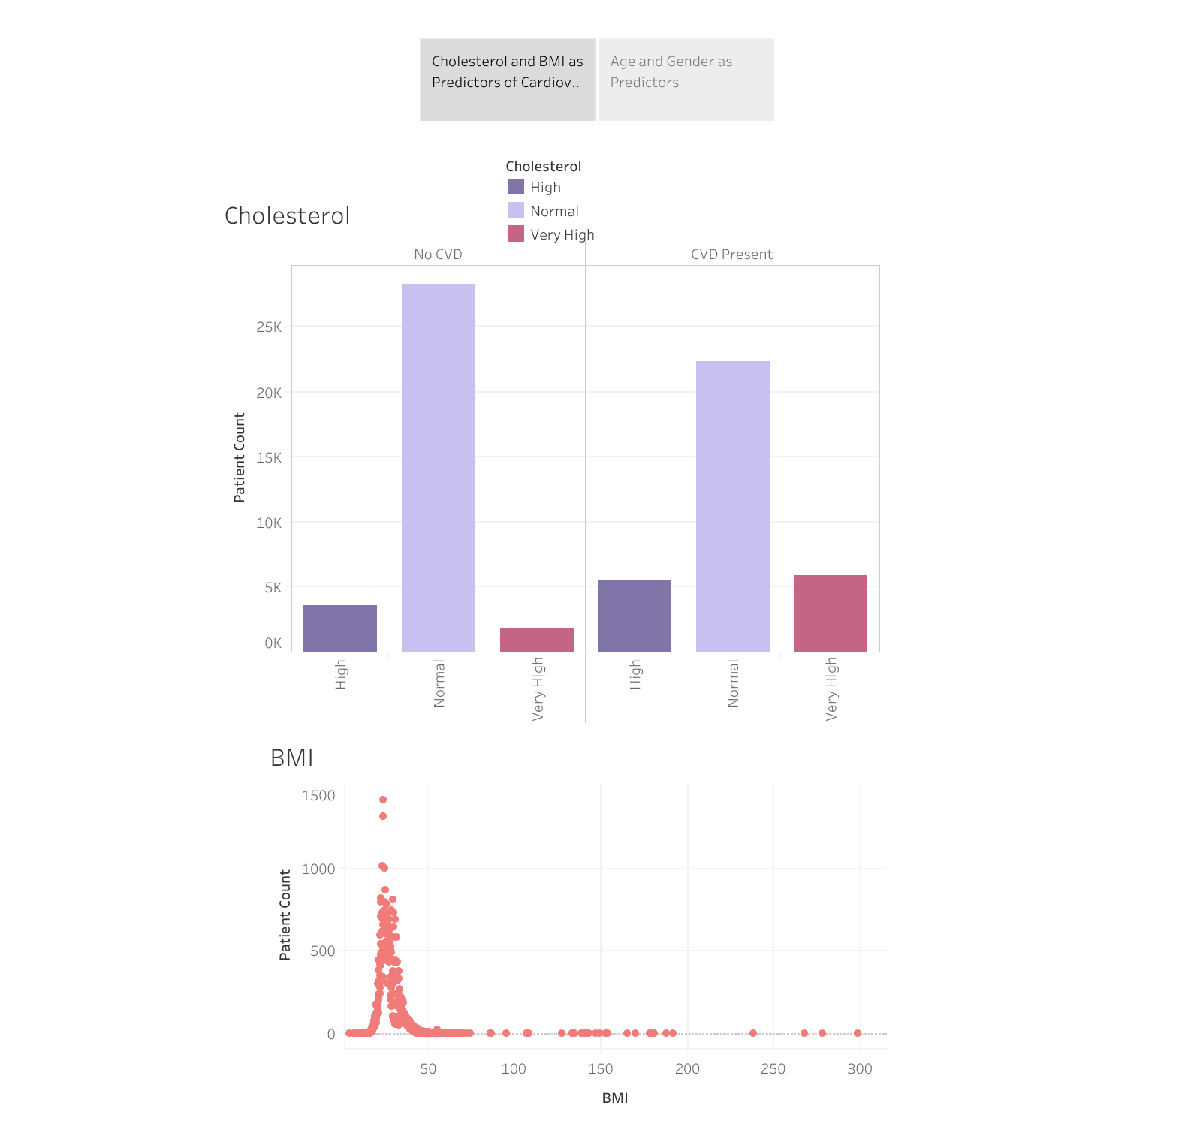

Slide 4
